Slide 1
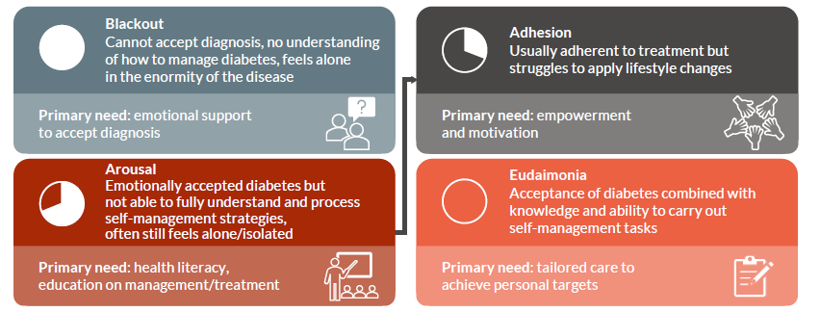
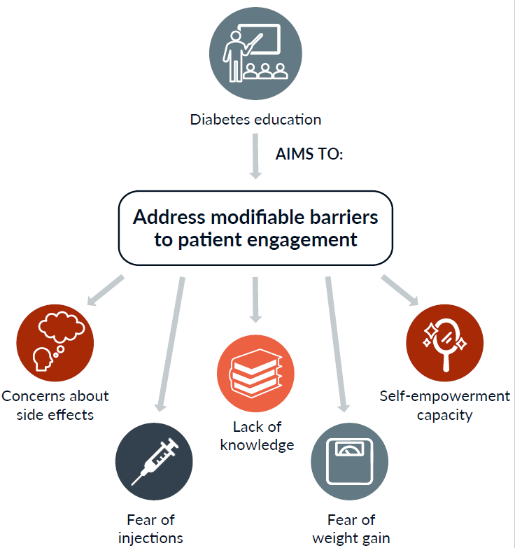


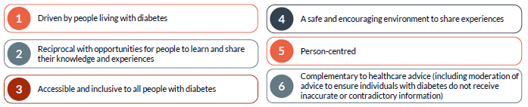

Engaging patients in diabetes management
Stages of patient engagement
To best support patients on their journey to engagement, it’s important to consider where they are currently.
Methods for increasing patient engagement
Education
Approximately 50% of people with type 2 diabetes have only superficial knowledge of the condition and its treatment. Without knowledge, engaging patients in lifelong self-management is unlikely.
Diabetes management education could be:
educational booklets
videos
peer group discussions
follow-up telephone calls
These are associated with improved blood glucose and blood pressure levels.
Peer support
Peer support improves confidence with diabetes management and self-management behaviours. Over time, it leads to improved blood glucose levels. Good peer support should be:
Family-based interventions
Friends and family have a large impact on lifestyle behaviours.
Family members often:
overestimate their loved one’s knowledge of diabetes
report not understanding the needs of their family member with diabetes
Including family members in diabetes education results in greater knowledge improvements and better patient outcomes.

Slide 2
Identifying diabetes distress in individuals with
type 2 diabetes
Identifying the Core Level of Distress (T2-DDAS CORE)
Diabetes can be a challenging condition to live with. Some people living with diabetes experience distress. Understanding whether you are experiencing diabetes
distress means you can seek out help if needed.
In the past month, consider how much of a problem each of the following statements have been for you. Give each statement a score based on the score chart to the right.
Category | Score
Not a problem | 1
A small problem | 2
A moderate problem | 3
A serious problem | 4
A very serious problem | 5
 | Score
I feel burned out by all of the attention and effort that diabetes demands of me. | ___________
It bothers me that diabetes seems to control my life. | ___________
I am frustrated that even when I do what I am supposed to for my diabetes, it doesn’t seem to make a difference. | ___________
No matter how hard I try with my diabetes, it feels like it will never be good enough. | ___________
I am so tired of having to worry about diabetes all the time. | ___________
When it comes to my diabetes, I often feel like a failure. | ___________
It depresses me when I realize that my diabetes will likely never go away. | ___________
Living with diabetes is overwhelming for me. | ___________
Total score (sum of all scores): | ___________
Average score (total score divided by 8): | ___________
Average score | Indication
<2.0 | Little or no distress
2.0–2.9 | Moderate distress
≥3.0 | High distress
Individuals with moderate or high distress should be offered support to manage their distress and referred to psychological support where available
T2-DDAS CORE scale developed by the Behavioral Diabetes Institute. Available at: https://diabetesdistress.org/dd-assess-score-4/

